Slide 1
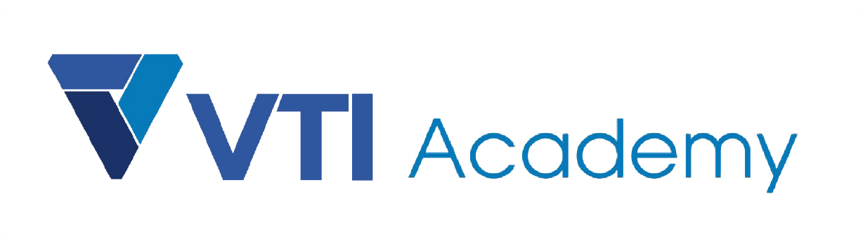
WAY TO ENTERPRISE
AWS
VTI ACADEMY
Author: duy.nguyenngoc1@vti.com.vn

Slide 2
Typical Architecture
Example 1: Web App - WhatIsTheTime.com
  Allow people to know what time it is
  You don’t need a database
  You want to start small and can accept downtime
  You want to fully scale vertically and horizontally, no downtime

Slide 3
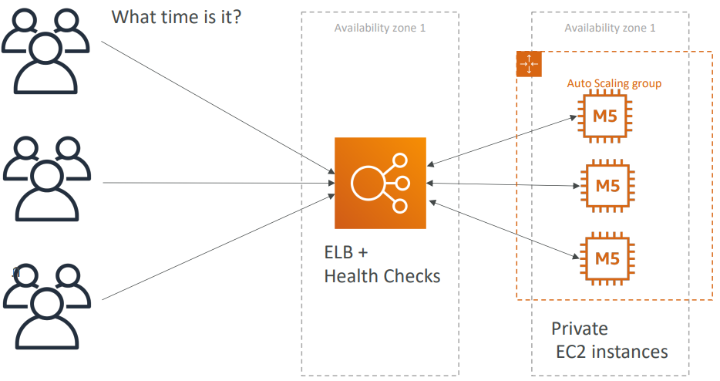
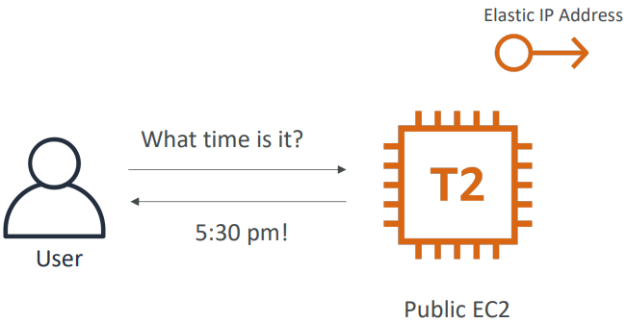
Typical Architecture
Simple
(EC2)
Scaling vertically
(Auto Scaling + ELB + HeathCheck)

Slide 4
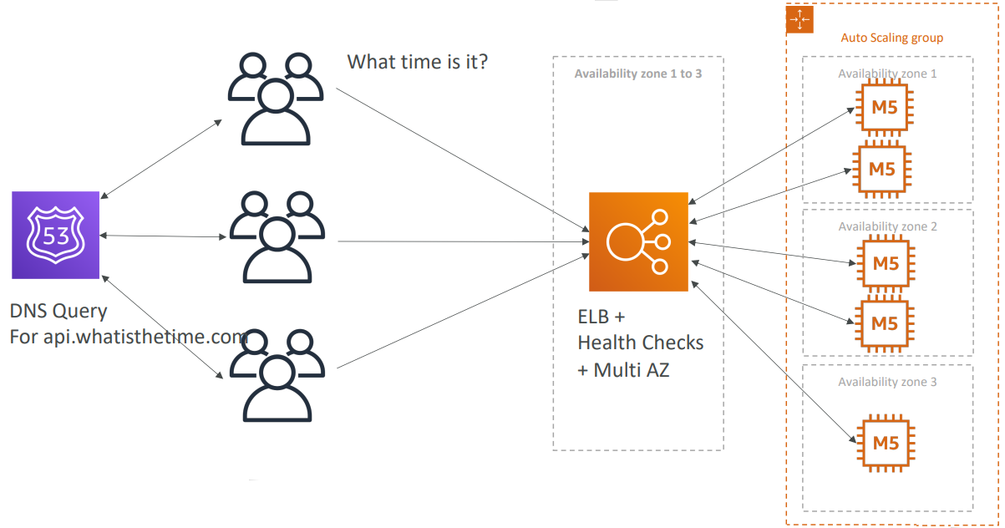
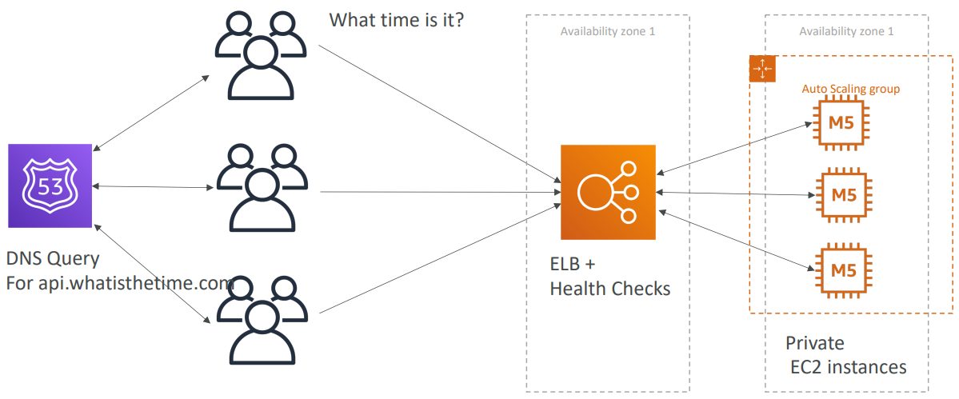
Typical Architecture
Add domain
(Route53)
Add multi A-Z

Slide 5
Typical Architecture
  Summary
    Public vs Private IP and EC2 instances
    Maintaining EC2 instances with Auto Scaling Groups & ELB with Health Checks
    Multi AZ to survive disasters
    Domain with Route53

Slide 6
Typical Architecture
Example 2: Stateless Web App: MyClothes.com
  Allow people to buy clothes online
  There’s a shopping cart
  Your website is having hundreds of users at the same time
  You need to scale, maintain horizontal scalability and keep your application as stateless as possible
  Users should not lose their shopping cart
  Users should have their details (address, ...) in a database

Slide 7
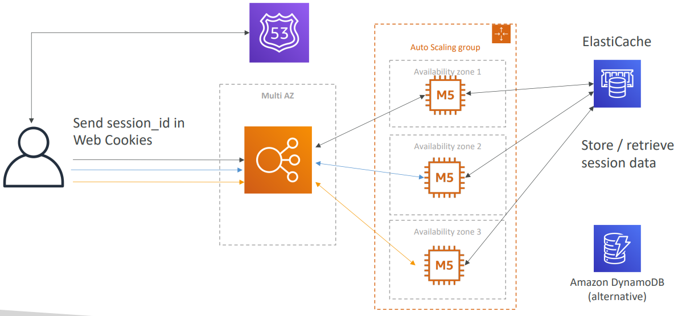
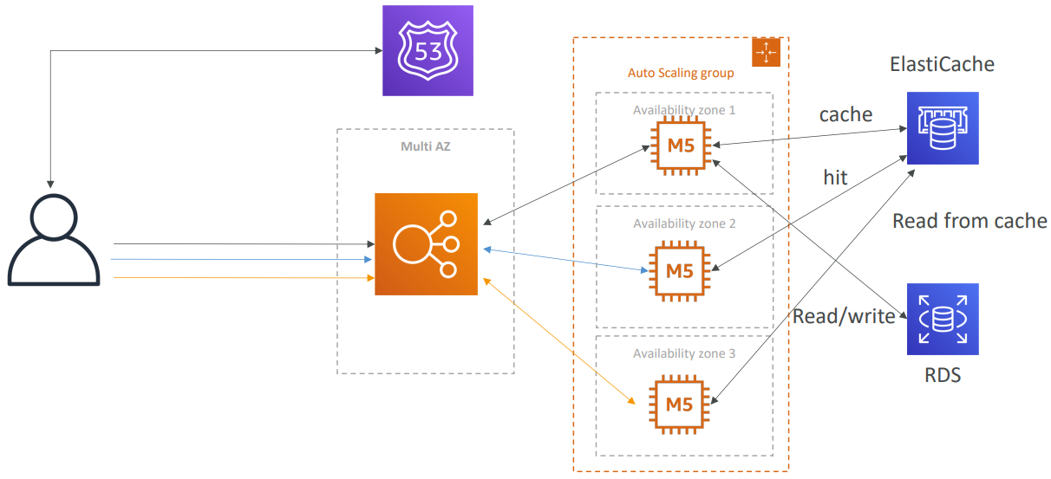
Typical Architecture
Add ElasticCache instead of ELB Session Affinity for saving User Cookies
(ElasticCache or DynamoDB + Multi A-Z)
Storing User Data in a database
(RDS)

Slide 8
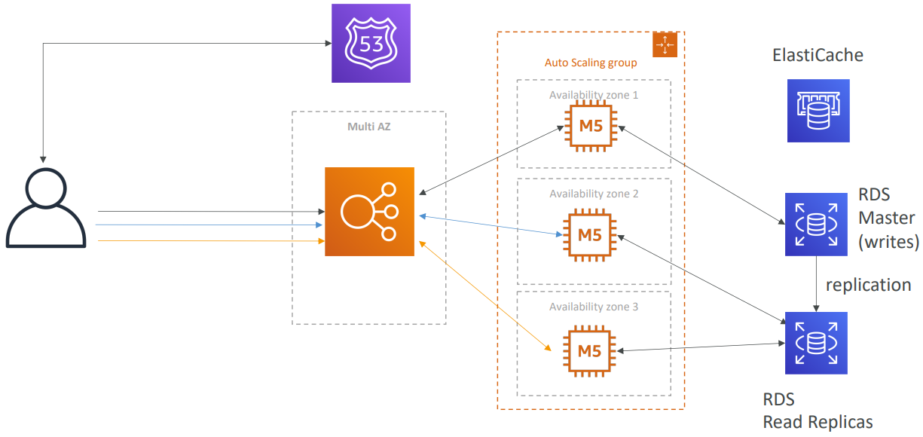
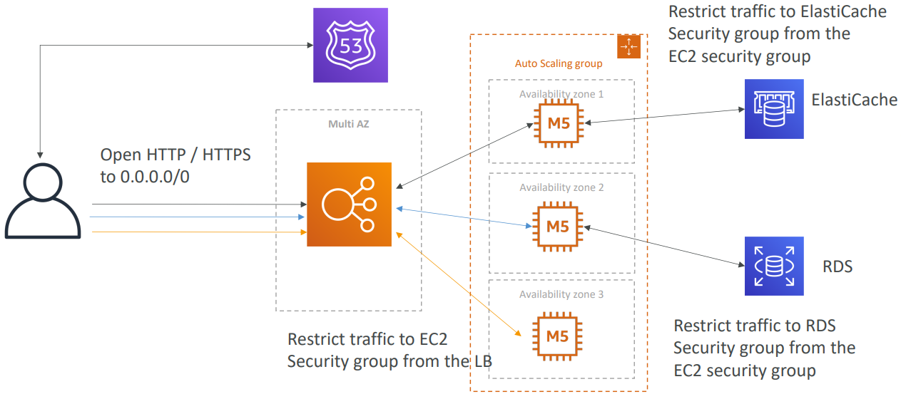
Typical Architecture
Scaling reads
(Add RDS Read Replicas)
Security Groups

Slide 9
Typical Architecture
  Summary
    ELB sticky sessions: caching for stateful app
    ElastiCache/DynamoDB : storing sessions for stateless app, caching data from RDS
    RDS: storing user data
    RDS Read replicas for scaling reads
    Multi AZ for disaster recovery
    Tight Security with security groups referencing each other

Slide 10
Typical Architecture
Example 3: Stateful Web App: MyWordPress.com
  You are trying to create a fully scalable WordPress website
  You want that website to access and correctly display picture uploads
  User data, and the blog content should be stored in a MySQL database.

Slide 11
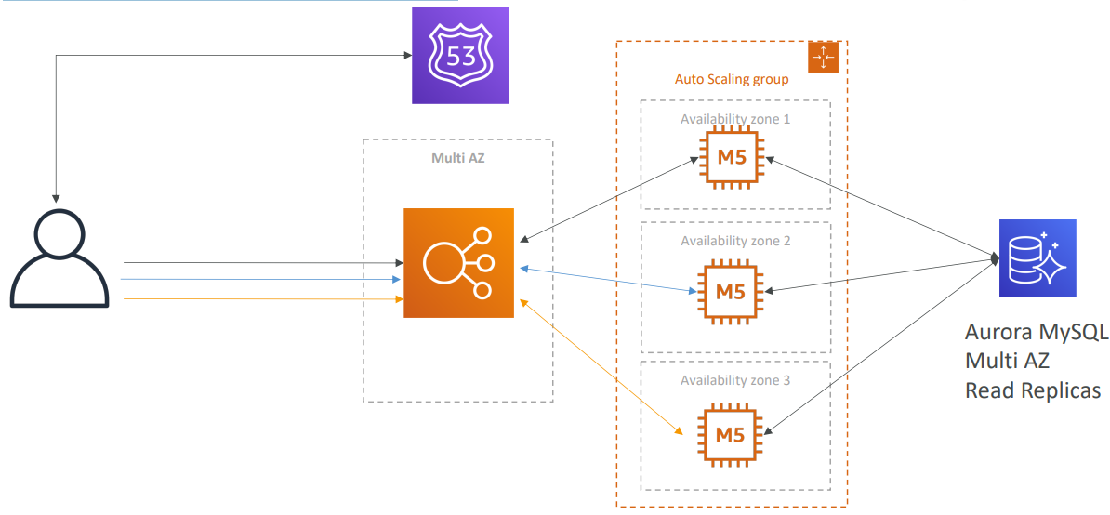
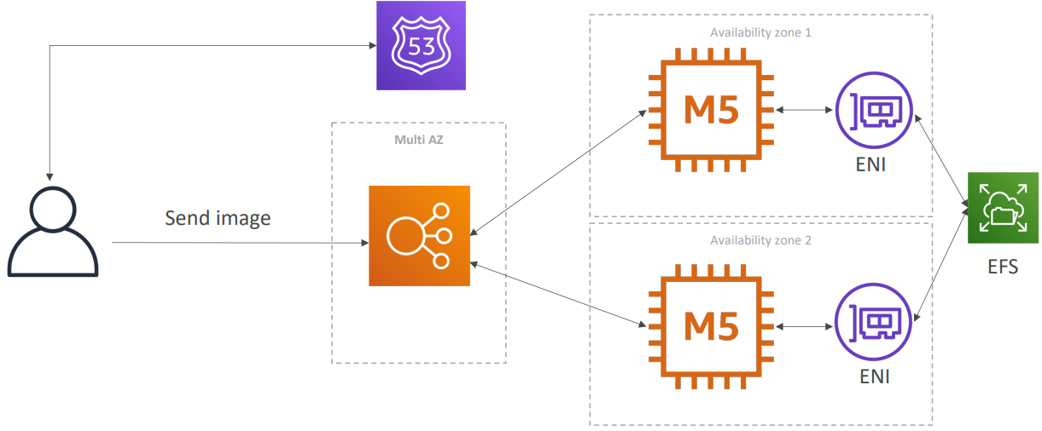
Typical Architecture
Scaling Database
(Aurora with Multi AZ & Read Replicas)
Storing images with EFS/S3

Slide 12
Typical Architecture
  Summary
    Aurora Database to have easy Multi-AZ and Read-Replicas
    Storing data in EBS (single instance application) Vs Storing data in EFS/S3 (distributed application)

Slide 13
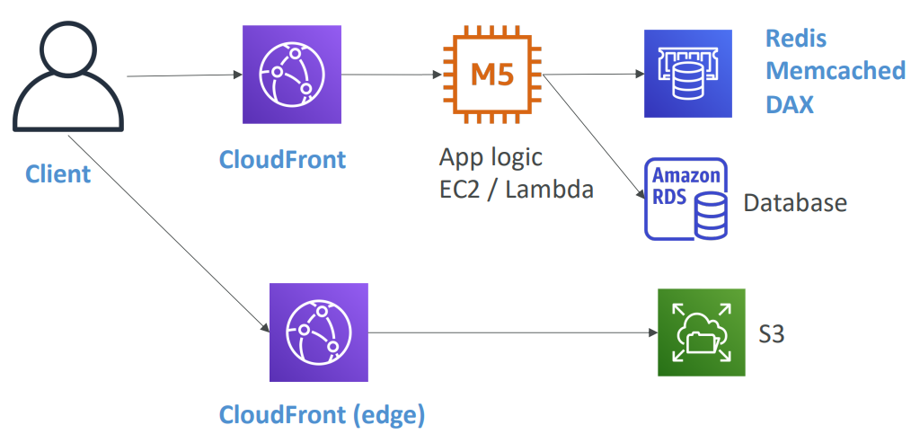
Typical Architecture
Example 4: Caching

Slide 14
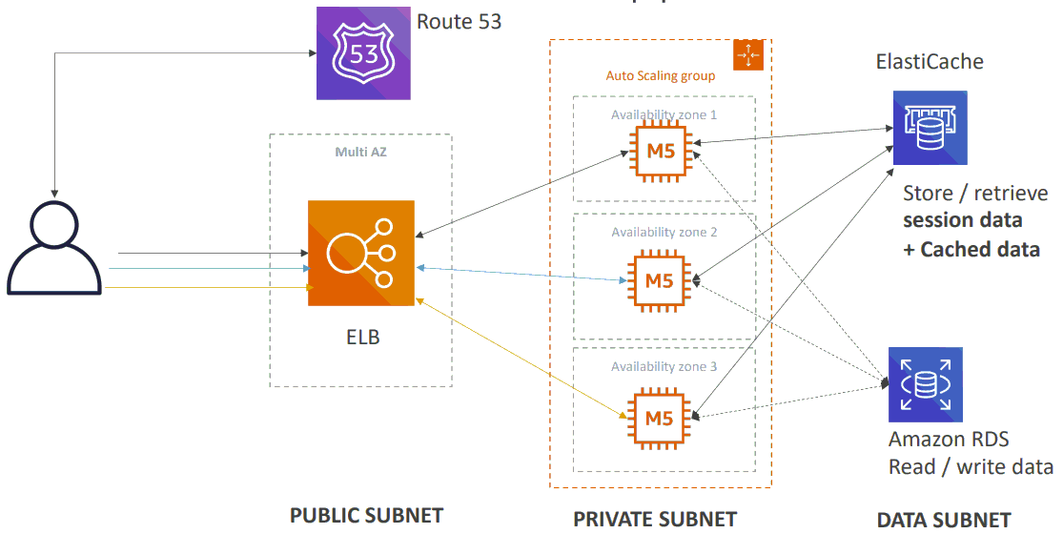
Typical Architecture
Summary

Slide 15
Q & A
Copyright © VTI Academy All Rights Reserved

